Slide 1
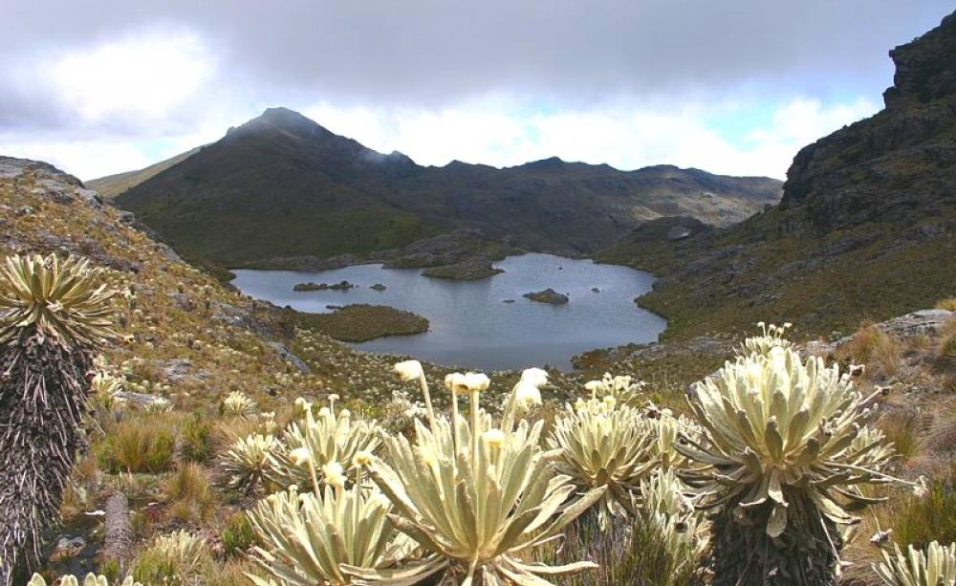
Biomes & Species Distributions

Slide 2
Learning goal
Identify the locations and key features of temperate rainforests, boreal forests, and tundra

Slide 3
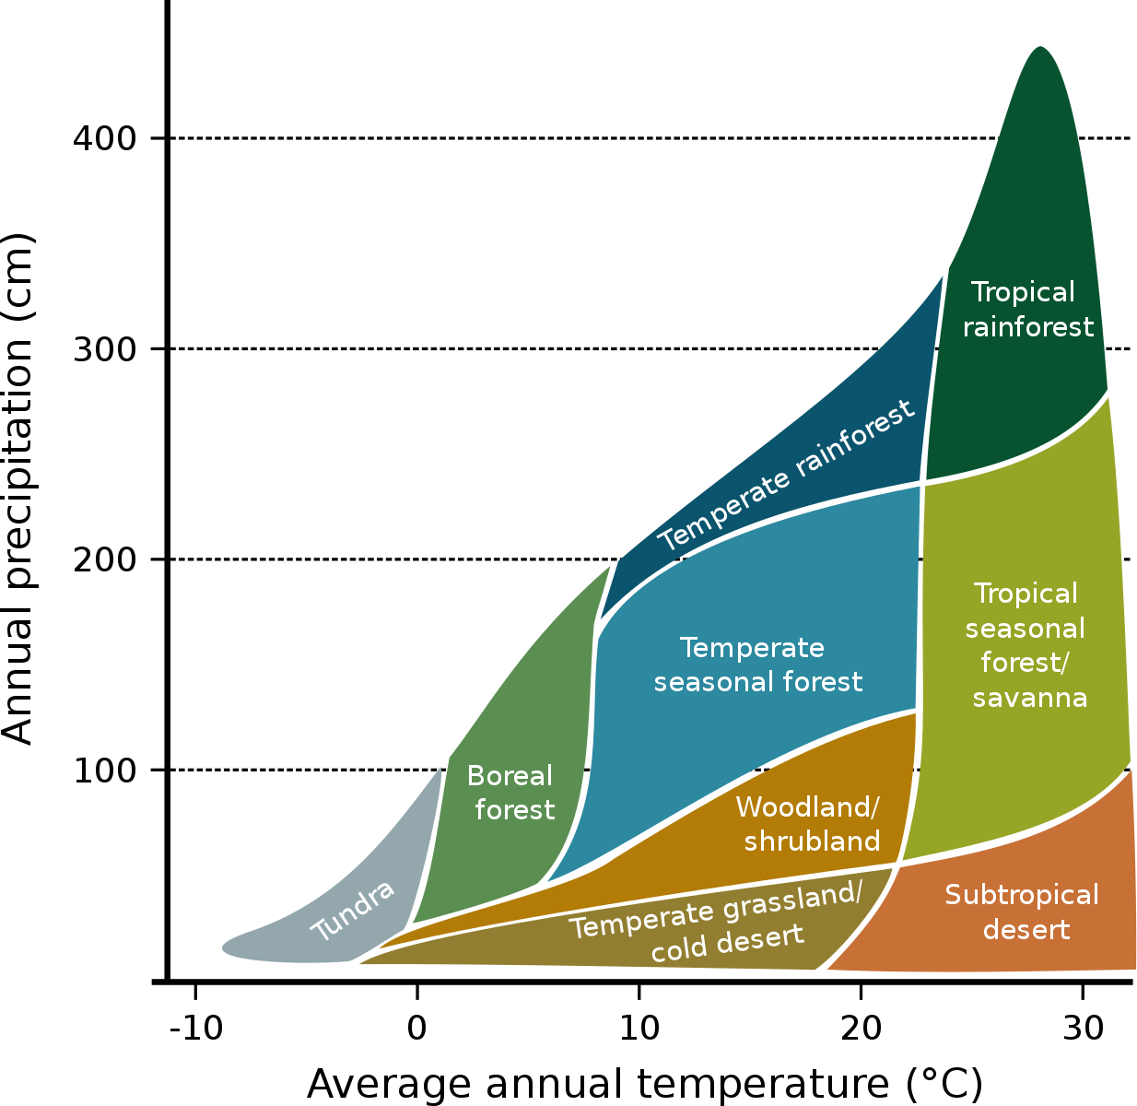

Slide 4
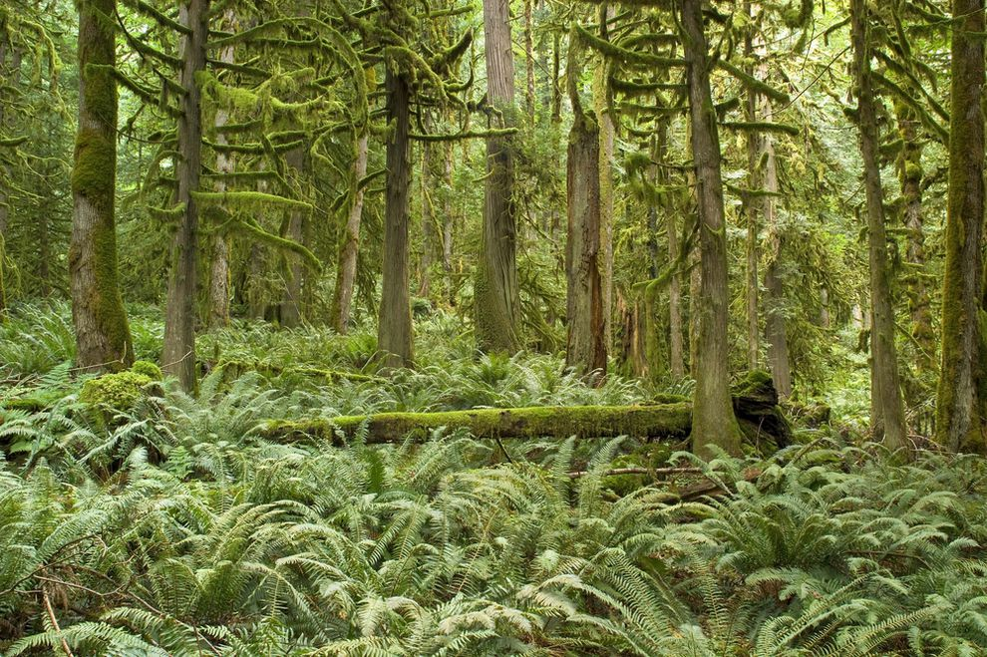
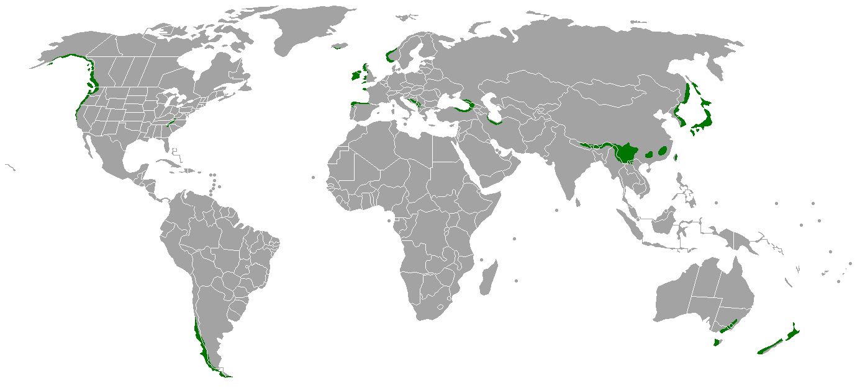
Temperate rainforest
Notes:
Figure 52.12 Exploring: Terrestrial Biomes

Slide 5
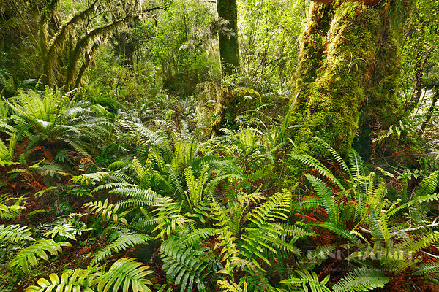
Temperate rainforest
Best developed along coasts between 40-55 degrees latitude with a cold ocean current
Pacific Northwest, New Zealand, Chile, Ireland
High rainfall, rains most months, with a brief (1-3 month) summer drought
Characterized by tall evergreen trees (broadleaf or coniferous), ferns, and abundant moss

Slide 6
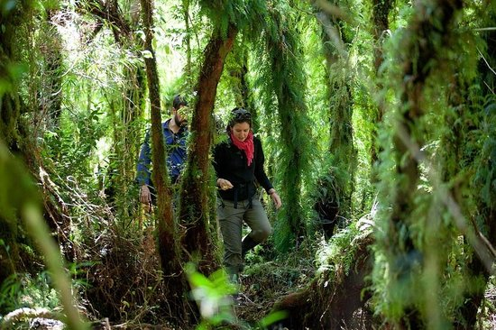
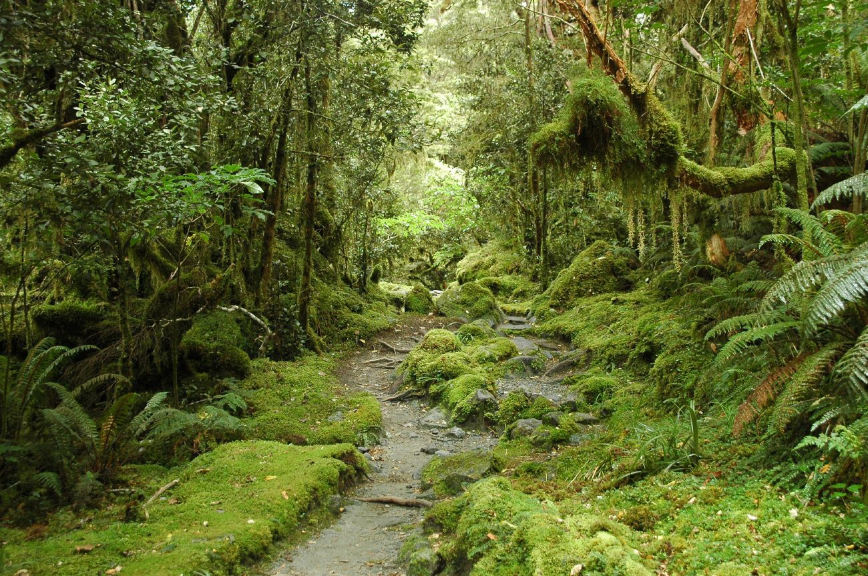
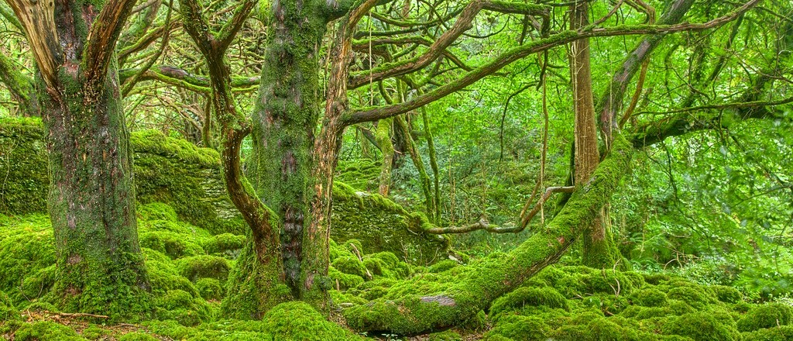
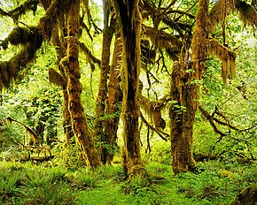
Temperate rainforest

Slide 7
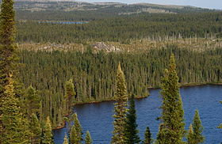
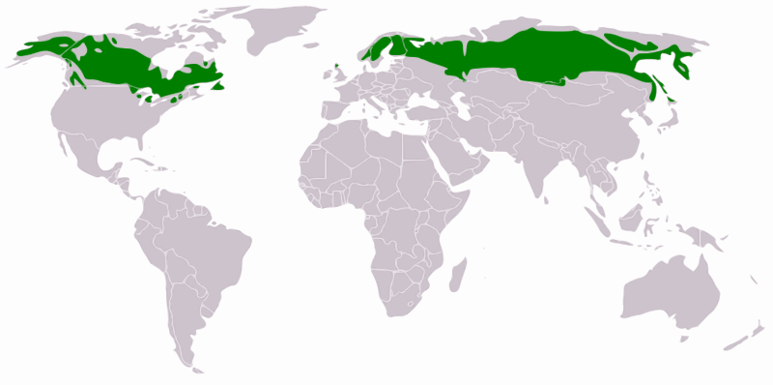
Boreal Forest
Notes:
Figure 52.12 Exploring: Terrestrial Biomes

Slide 8
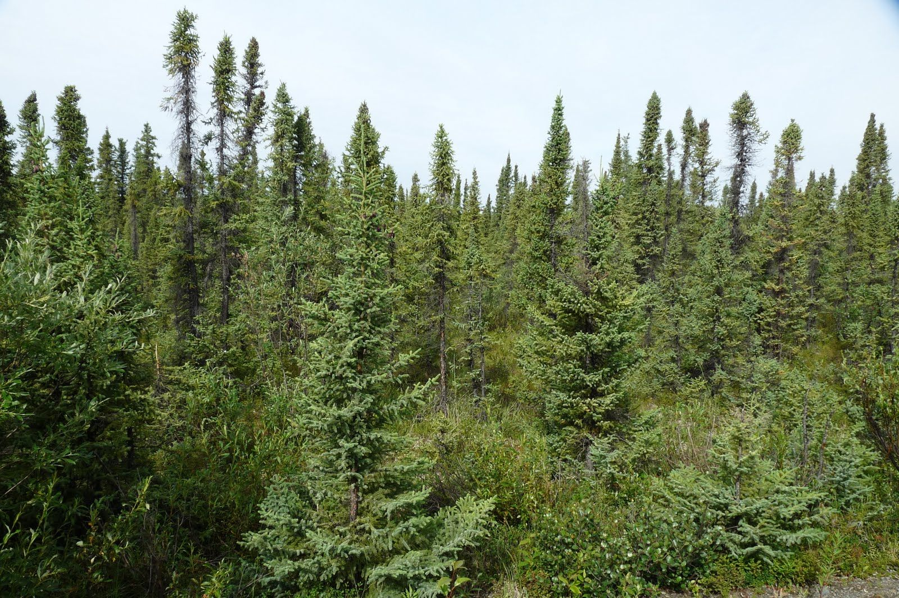
Boreal forest
Between 50 degrees N latitude and Arctic Circle
Absent in southern hemisphere
Cold most of year, short growing season
Characterized by evergreen coniferous trees
Low species diversity

Slide 9
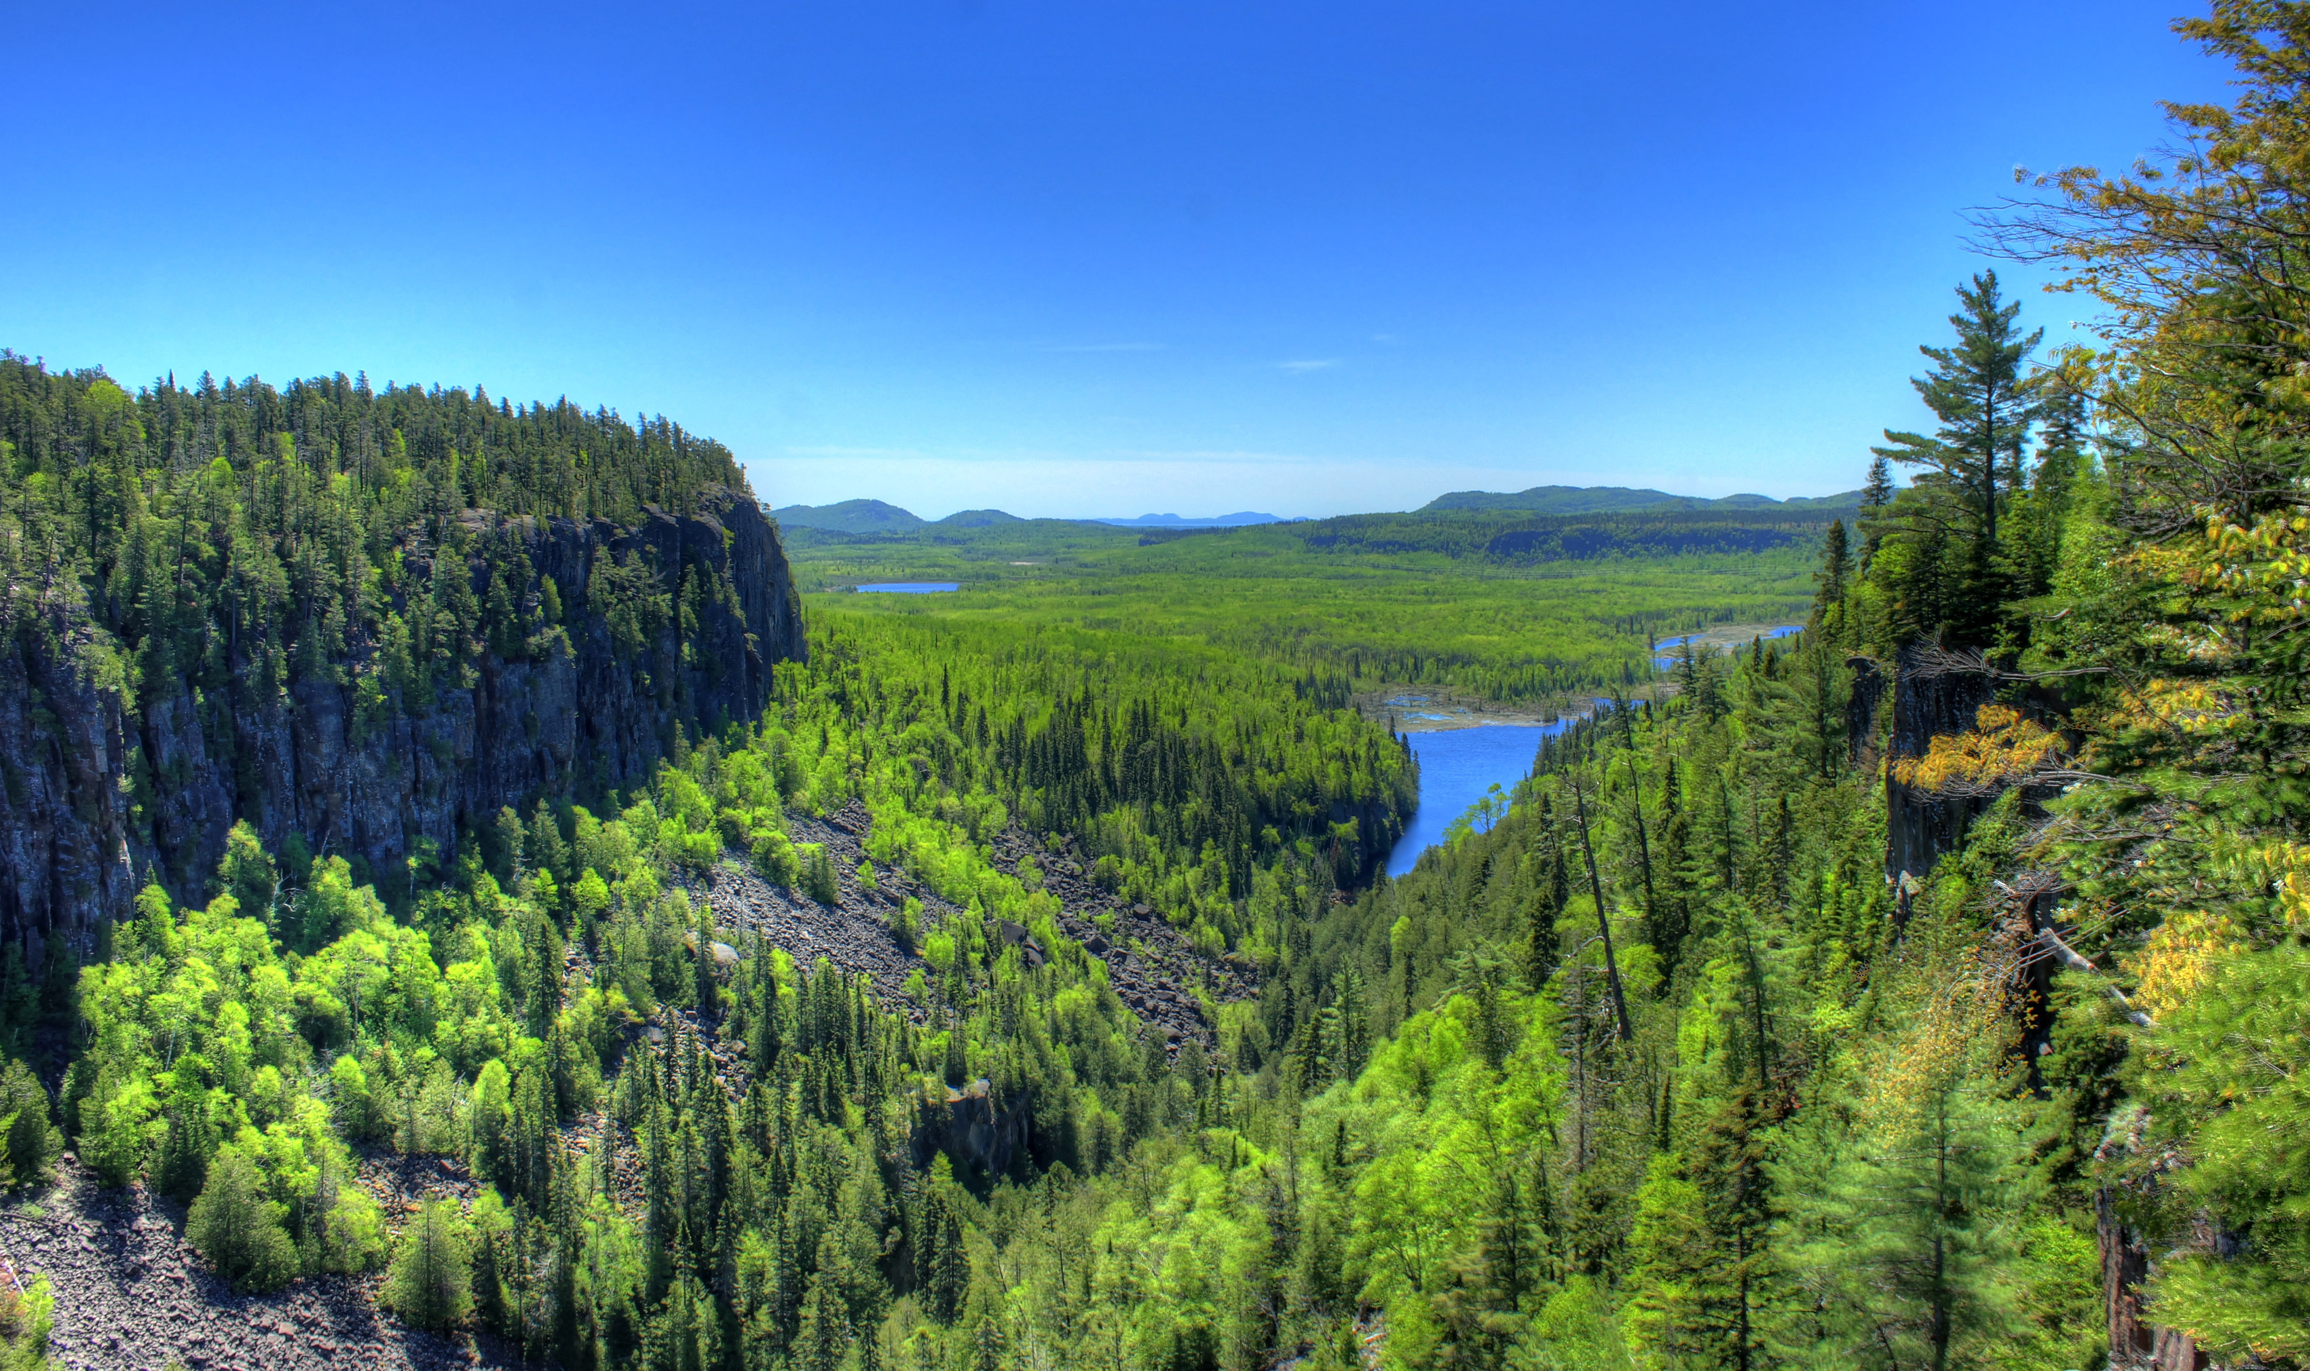
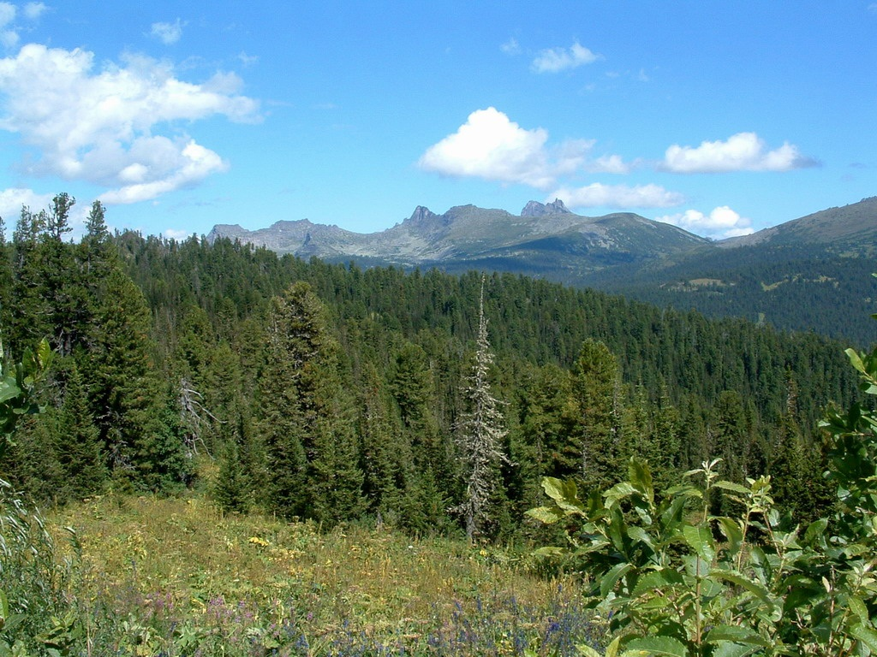
Boreal Forest

Slide 10
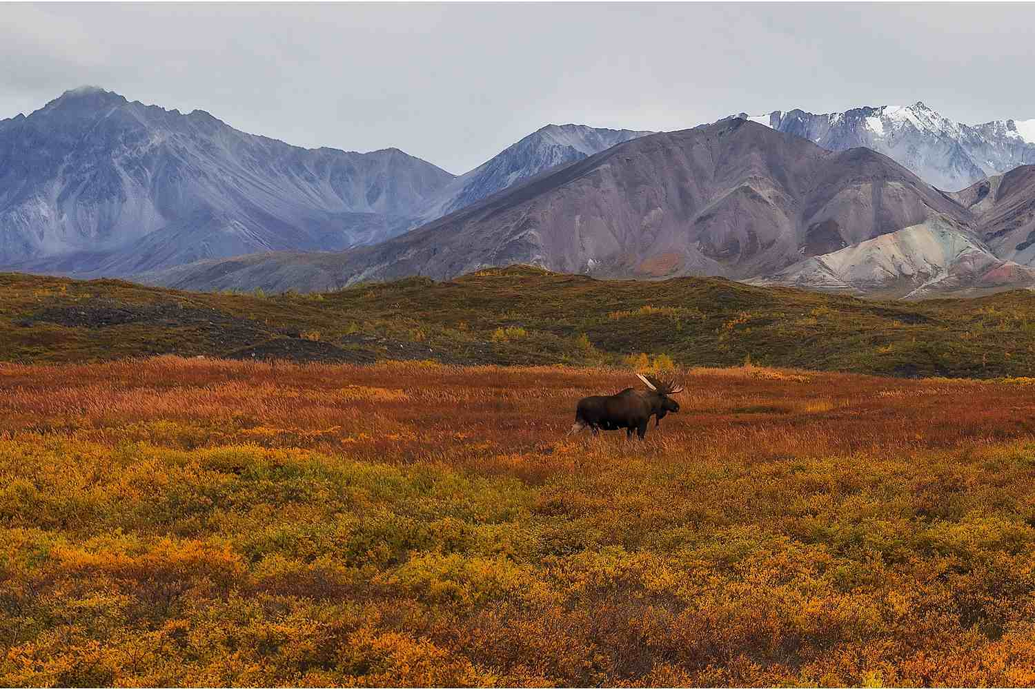
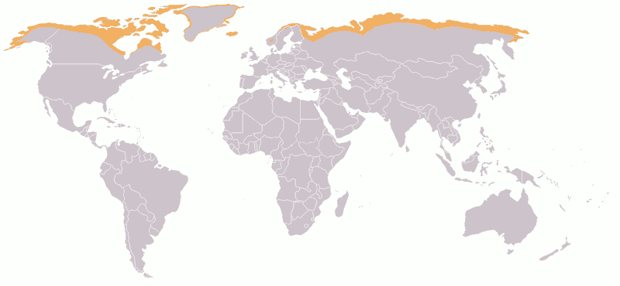
Tundra
Notes:
Figure 52.12 Exploring: Terrestrial Biomes

Slide 11
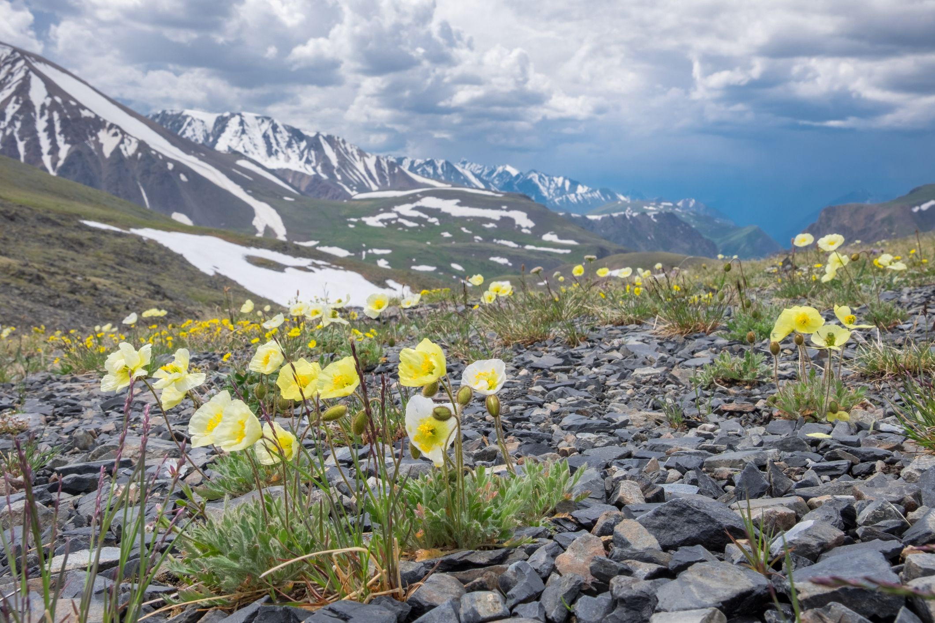
Tundra
Between poles and Arctic/Antarctic circle where there is not year-round ice
Cold most of year, growing season of 1-2 months
Little rainfall, and little evaporation
Characterized by dwarf shrubs and herbaceous plants, trees absent
Low species diversity

Slide 12
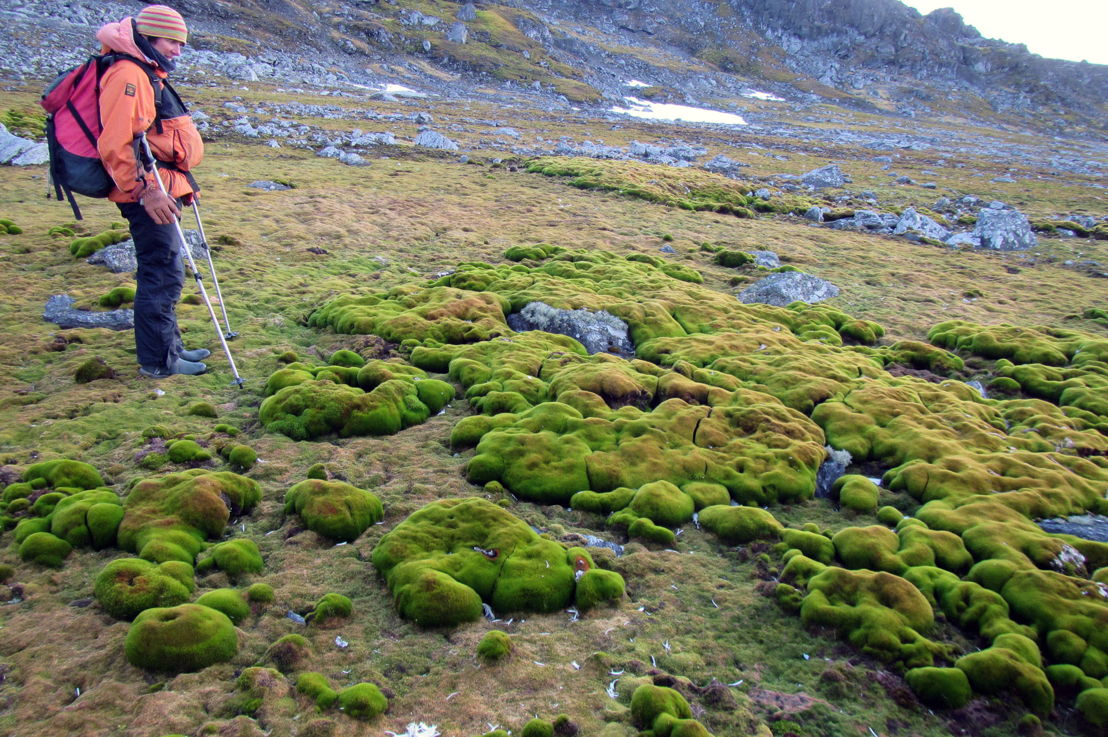
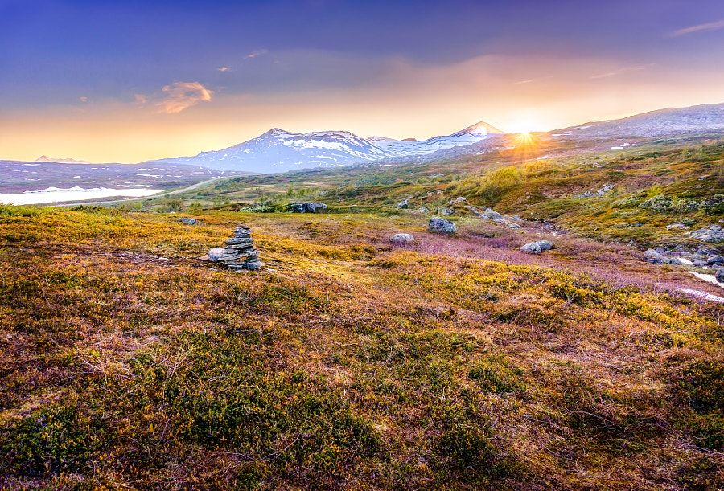
Tundra

Slide 13
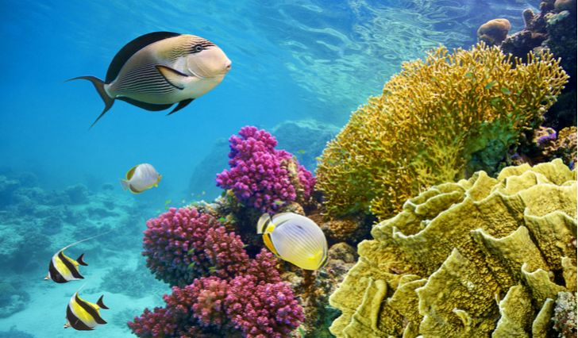
Biomes & Species Distributions

Slide 14
Learning goal
Be able to describe and diagram zones in aquatic biomes

Slide 15
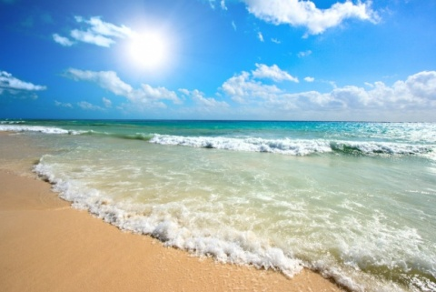
Aquatic biomes
Aquatic biomes cover most of the biosphere—we live on a water planet
Aquatic biomes are characterized by their physical and chemical properties
Oceans cover 75% of the Earth’s surface. Freshwater systems cover a small fraction

Slide 16
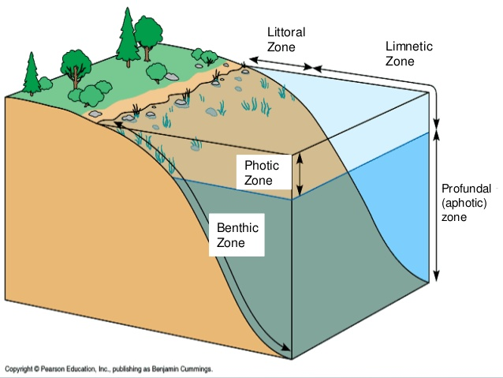
Zonation in aquatic biomes
Aquatic biomes are stratified (layered)
Photic and aphotic (also called profunal) zones
Benthic zone

Slide 17
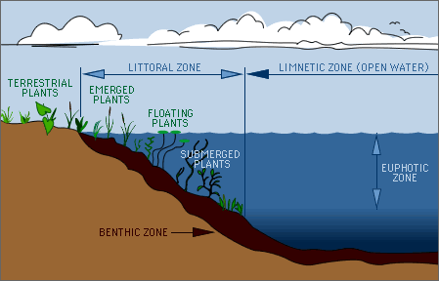
Zones Found in Lakes
Littoral zone
Limnetic zone

Slide 18
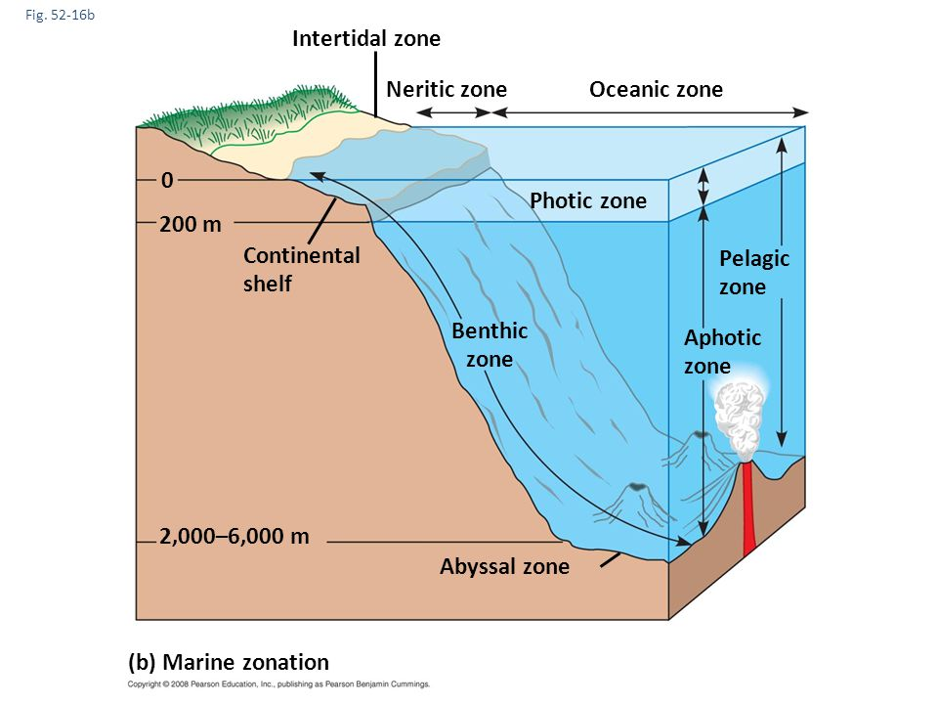
Zones Found in
Marine Ecosystems
Intertidal zone
Neritic zone
Oceanic zone

Slide 19
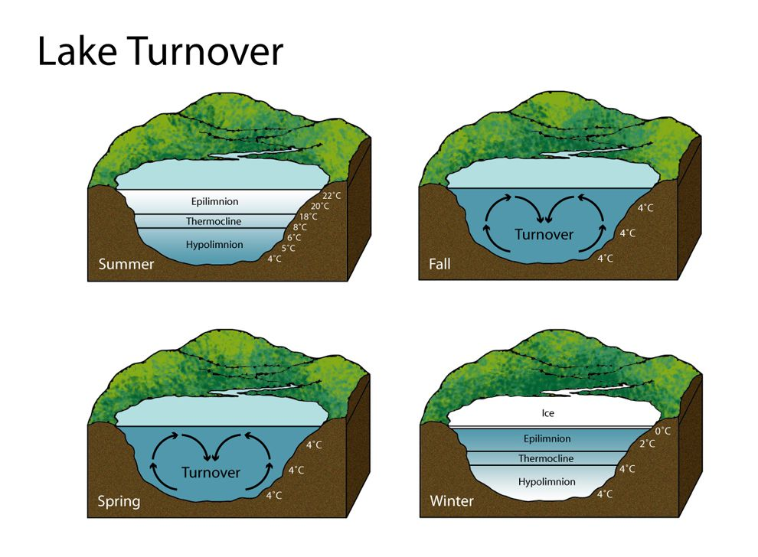
Stratification of water temperature in lakes
Thermocline - the sharp transition between an upper warm layer of water and a lower cold layer of water
Turnover - semi-annual mixing of water in temperate zone lakes

Slide 20
Biomes & Species Distributions

Slide 21
Learning goal
Be able to describe distinguishing features of freshwater and marine biomes

Slide 22
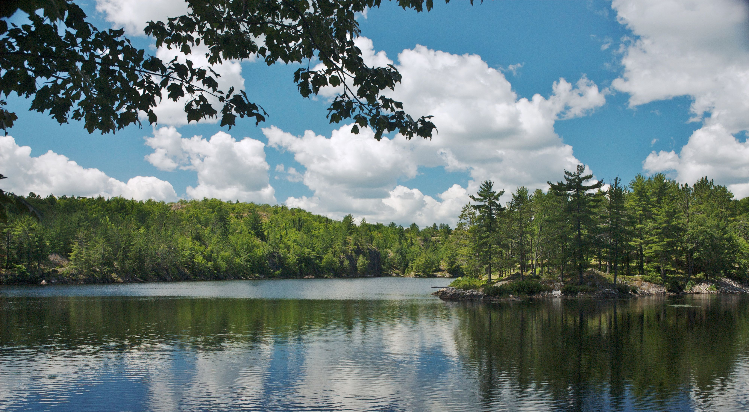
Freshwater biomes: lakes
Standing bodies of water
Receive water from precipitation, runoff from the watershed, sometimes groundwater
Vary in productivity
Oligotrophic
Eutrophic

Slide 23
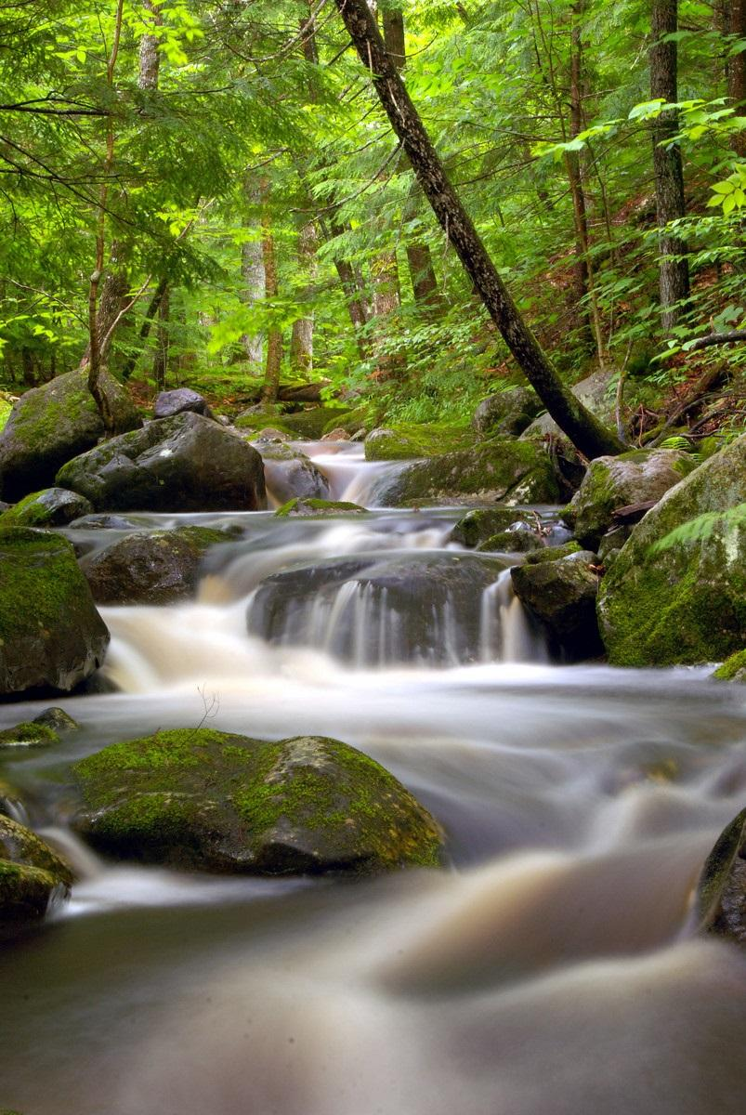
Freshwater biomes: rivers and streams
Moving bodies of water
Receive water from precipitation, runoff from the watershed, sometimes groundwater
Characterized by their volume of flow and speed

Slide 24
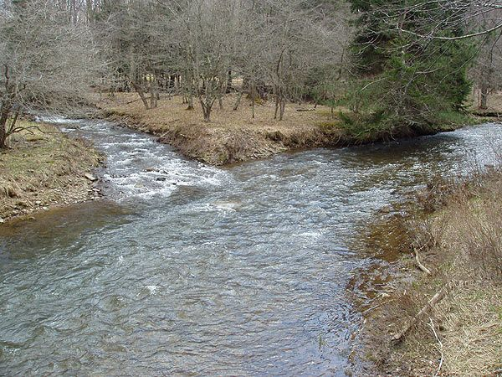
Freshwater biomes: rivers and streams
Confluence - the joining of streams, resulting in increased volume of flow

Slide 25
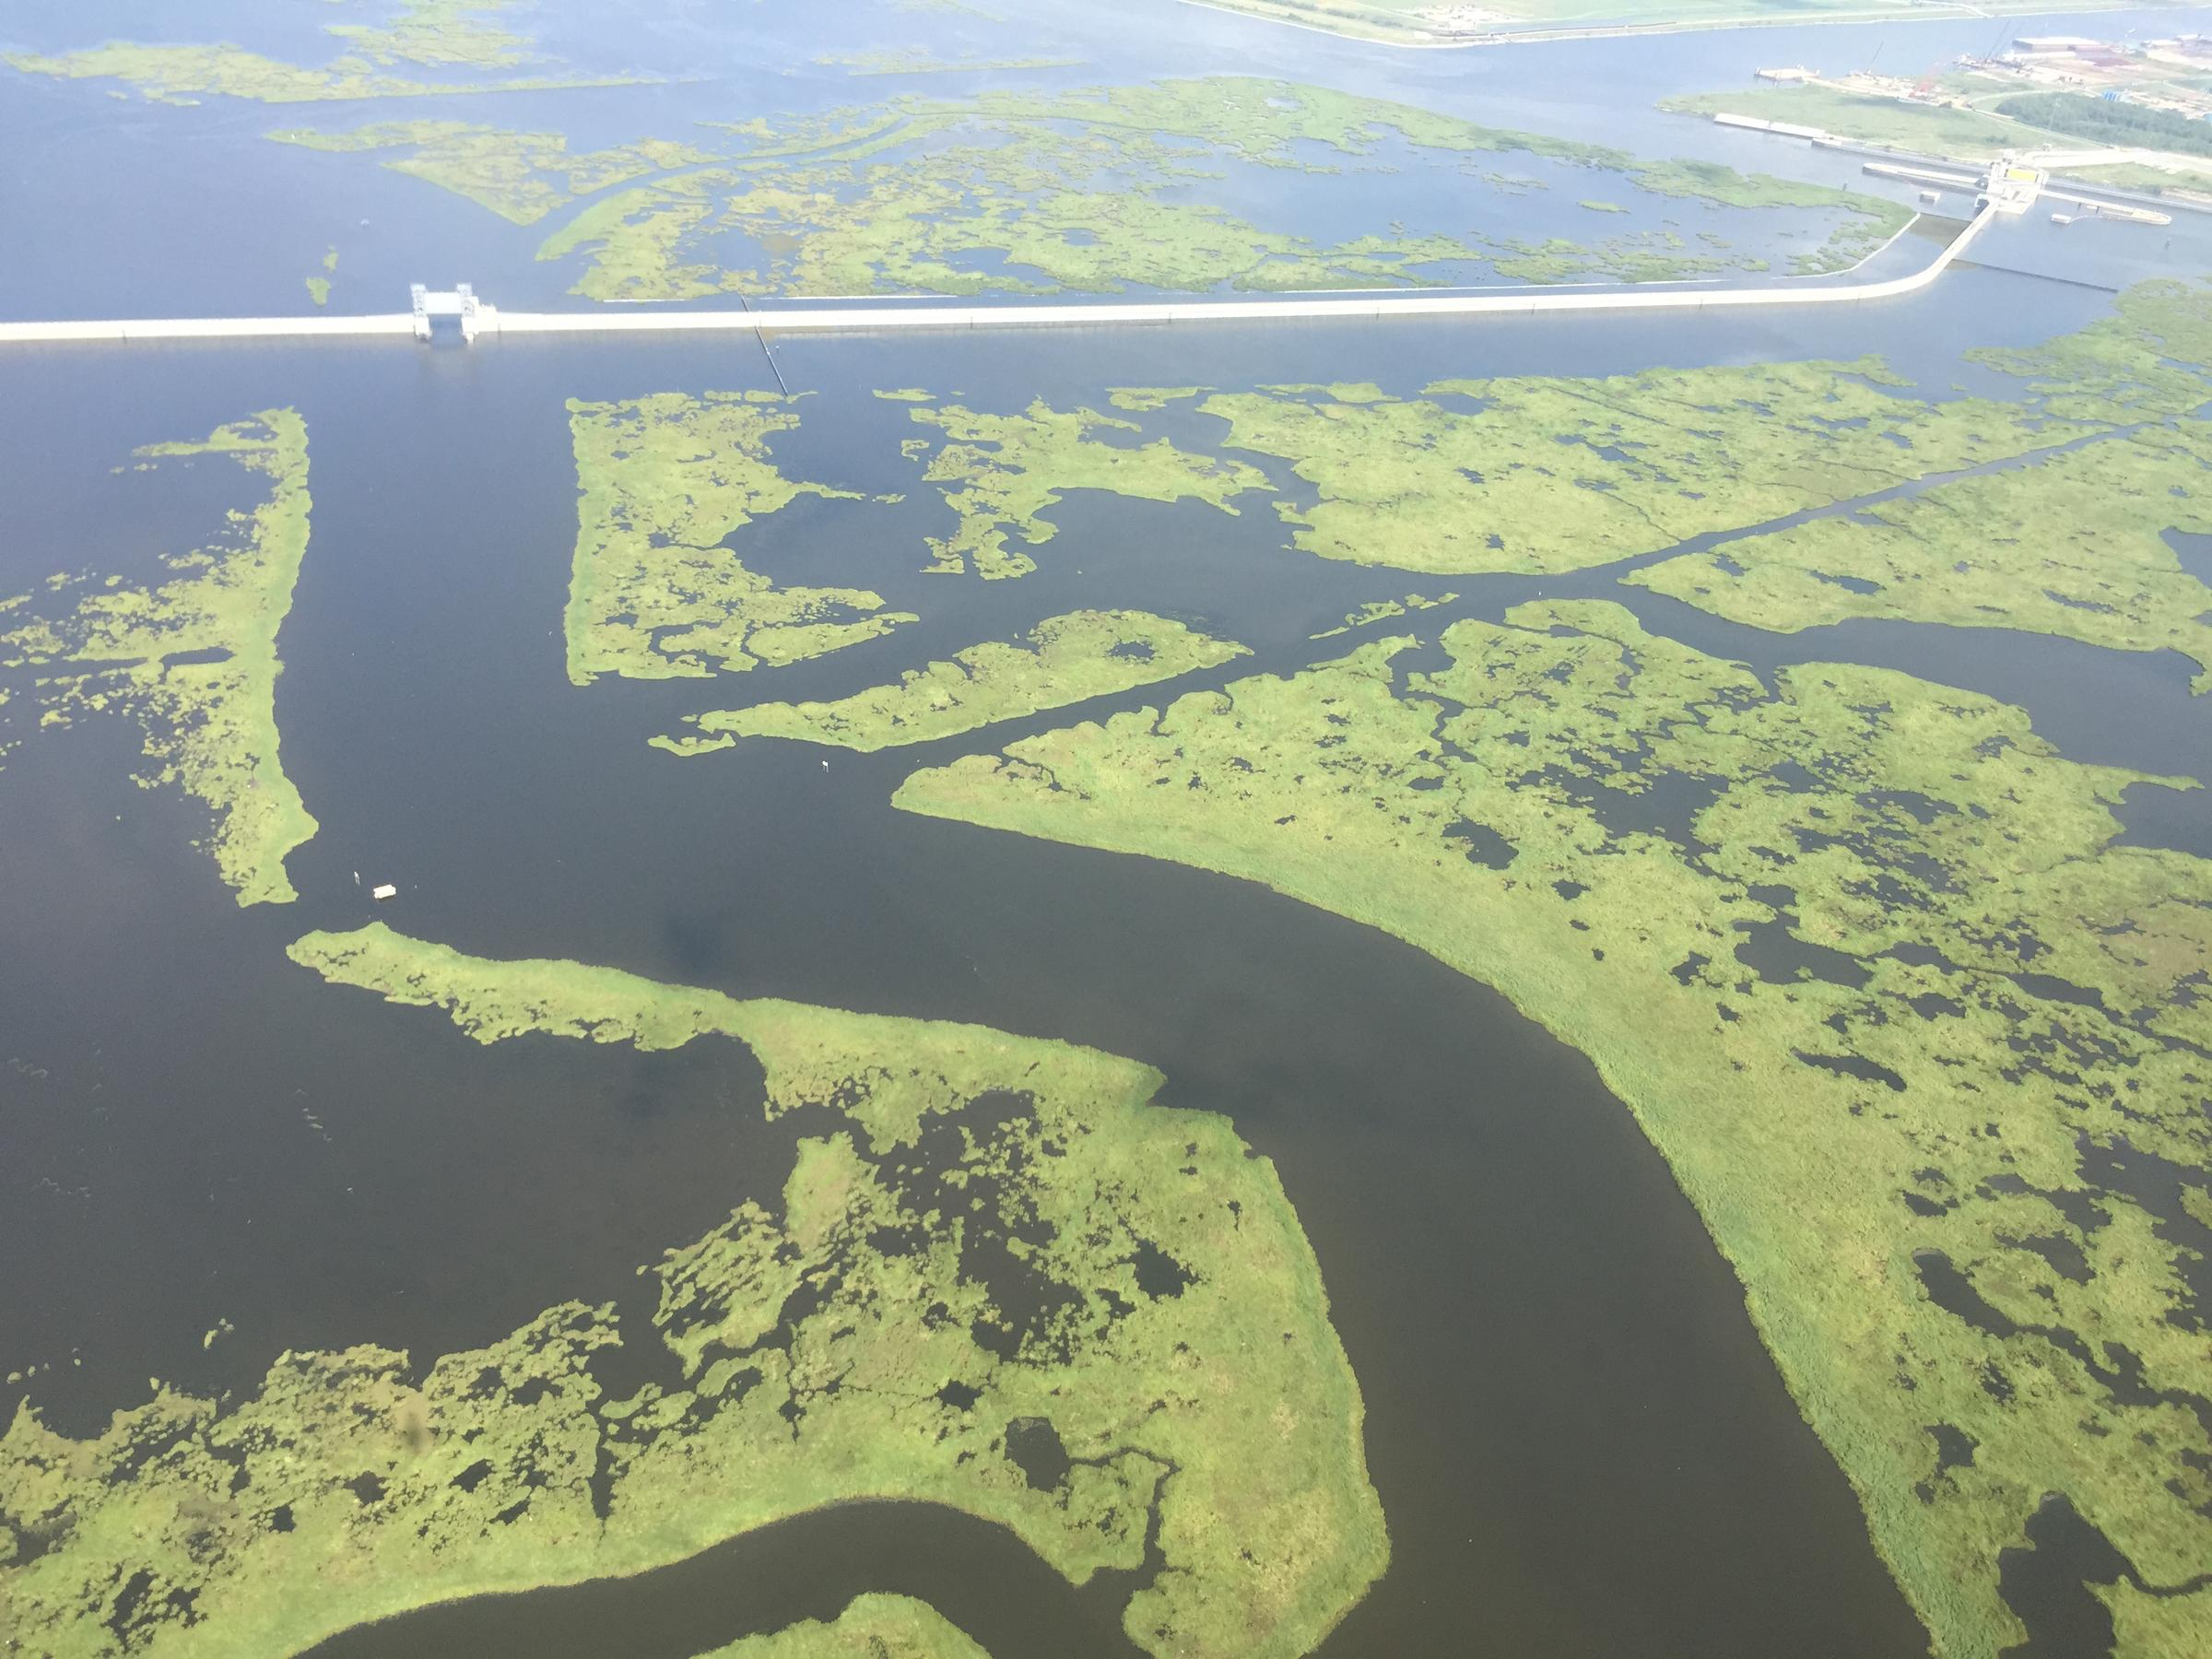
(Mostly) Freshwater biomes: estuaries
Transition between rivers and sea
Very productive, supporting large numbers of marine and freshwater species

Slide 26
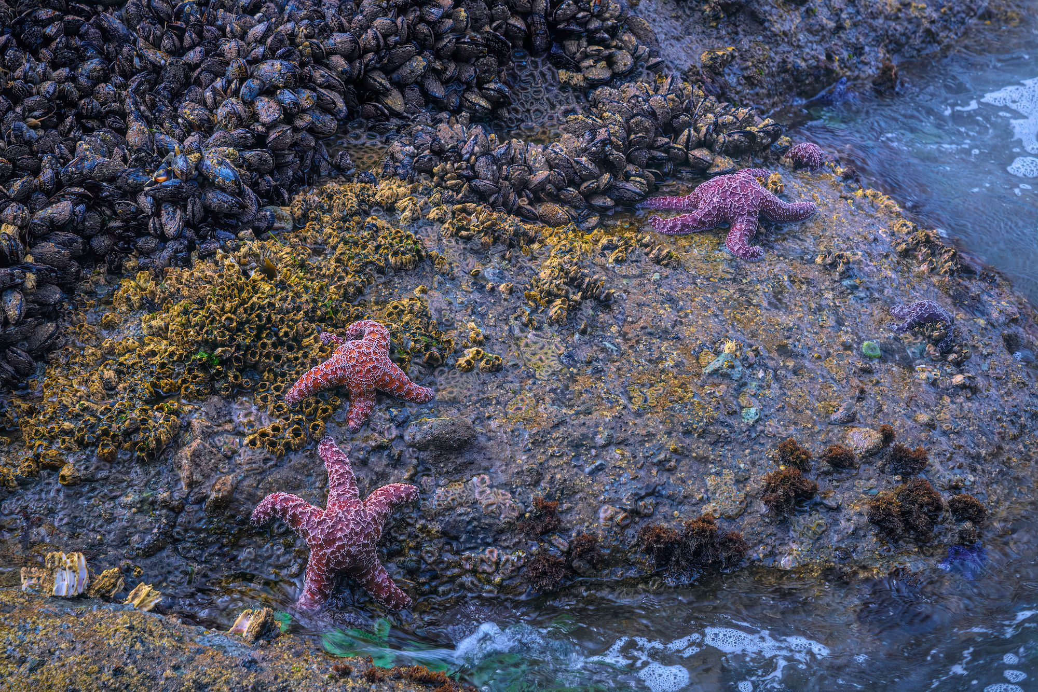
Marine biomes: intertidal zone
Zone between low and high tide
High tide refreshes nutrients
In rocky intertidal, organisms have adaptations for attachment to substrate

Slide 27
Marine biomes: coral reefs
Formed by the calcium carbonate skeletons built by corals
Nearly all are confined to the photic zone in tropical waters with high water clarity
Very productive, supports abundant fish and other animal life

Slide 28
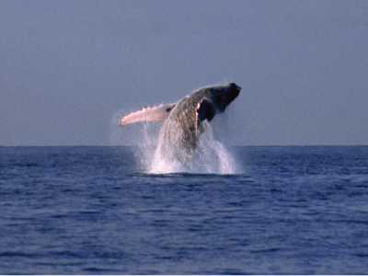
Marine biomes: pelagic zone
Open water mixed by wind and ocean currents
Photic zone penetrates deep
Dominant lifeform is phytoplankton

Slide 29
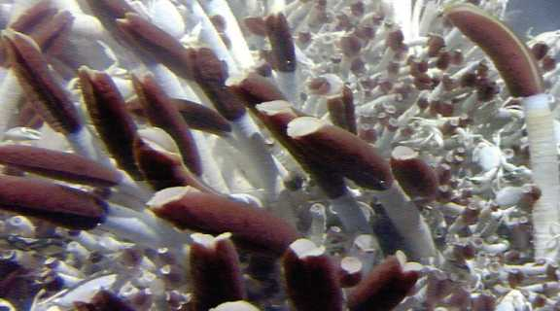
Marine biomes: benthic zone
Includes seafloor in neritic and oceanic zones
Coral reefs are part of the benthic zone
Deep sea hydrothermal vents in the oceanic zone

Slide 30
Biomes & Species Distributions

Slide 31
Learning goal
Identify the historic, biotic, and abiotic factors that explain the geographic distribution of species

Slide 32
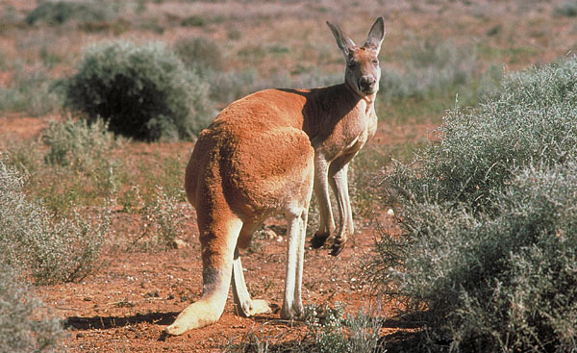
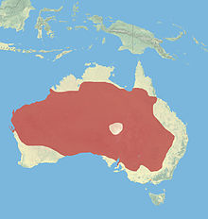
Geographic range of red kangaroo

Slide 33

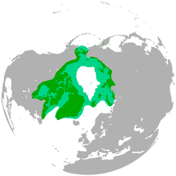
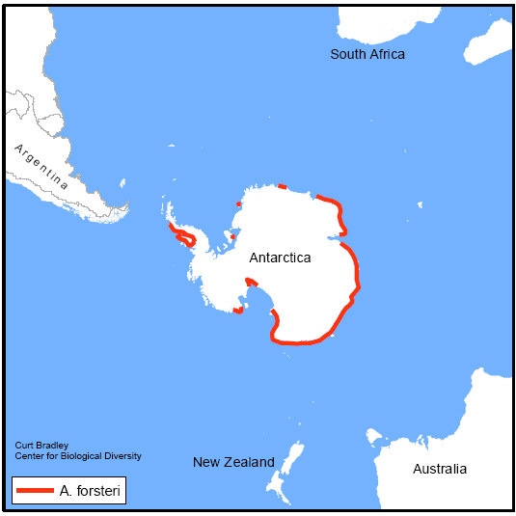

Slide 34
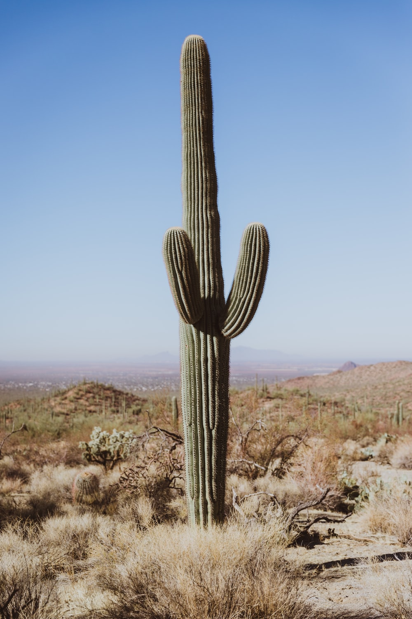
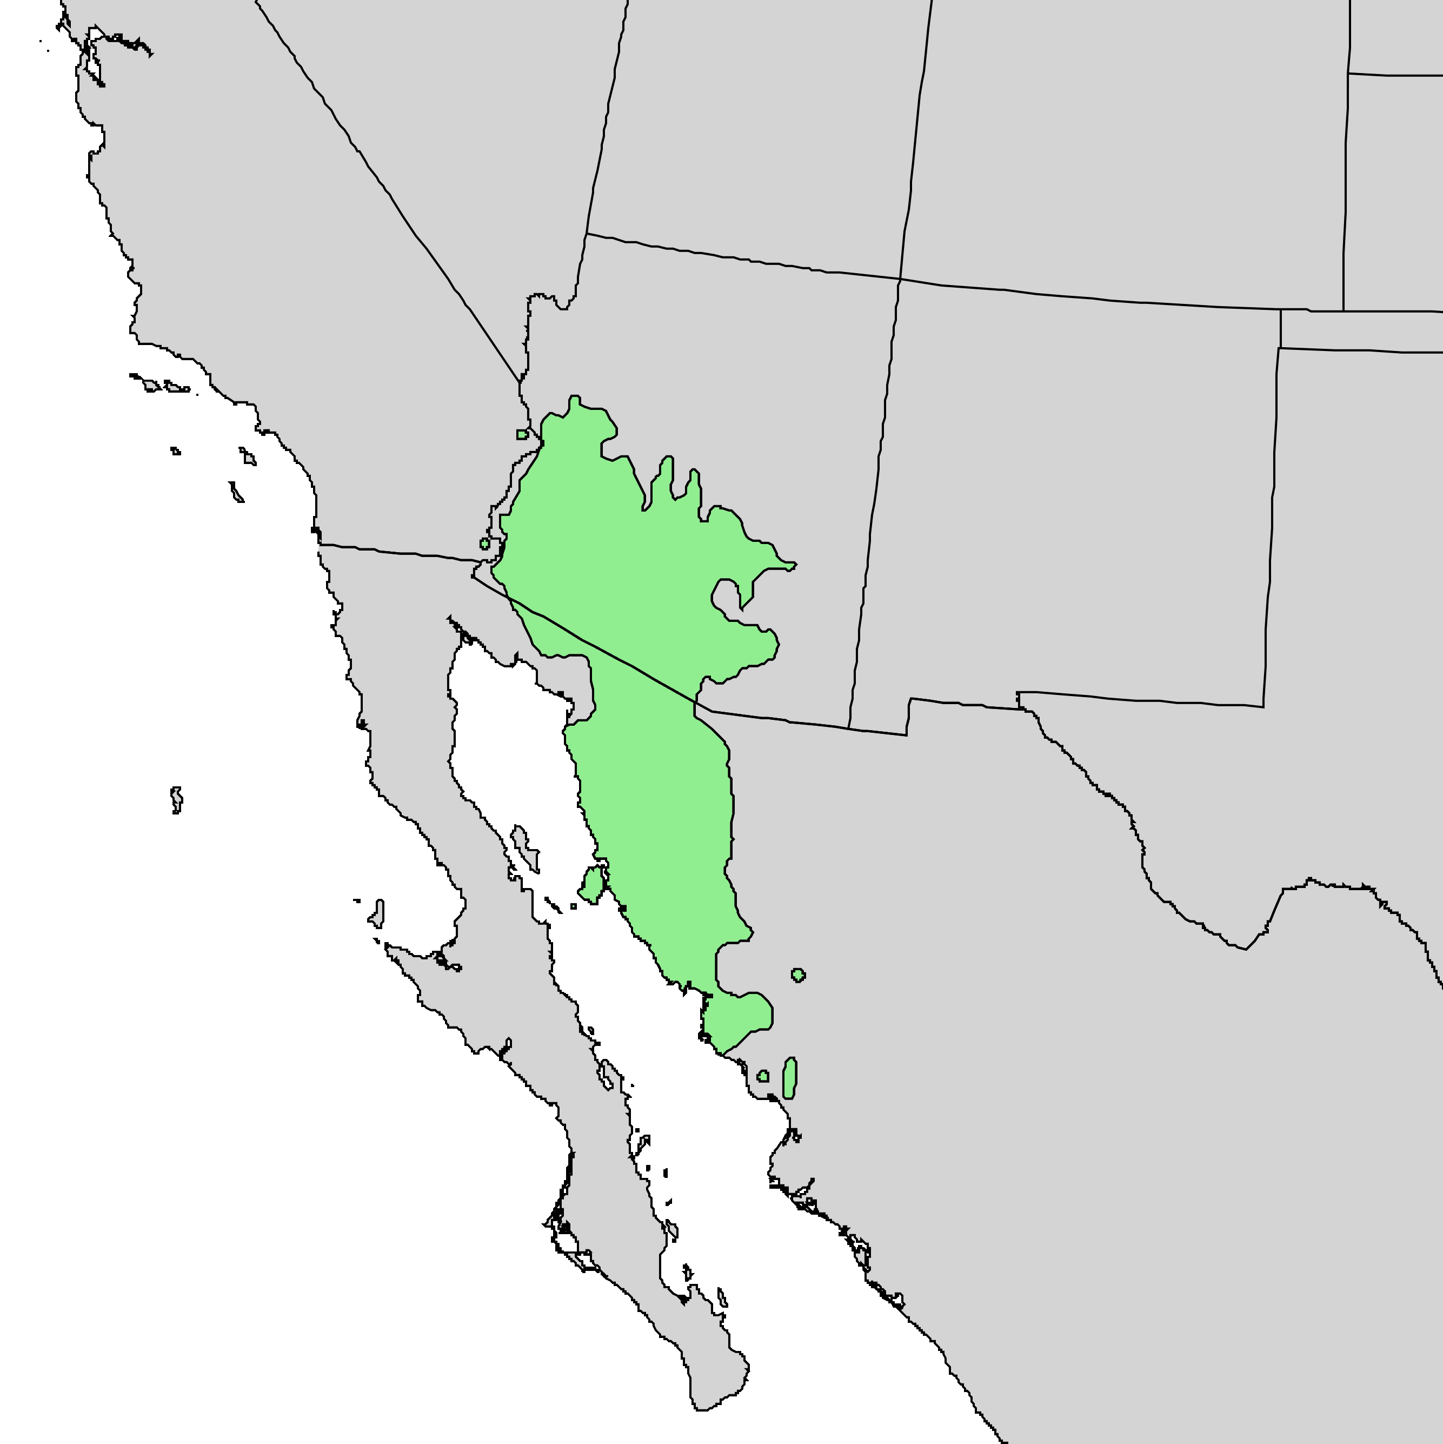
Distribution of saguaro cactus
Occurs in Sonoran desert
Northern limit determined by temperature
What about limits to the west, east, south?

Slide 35
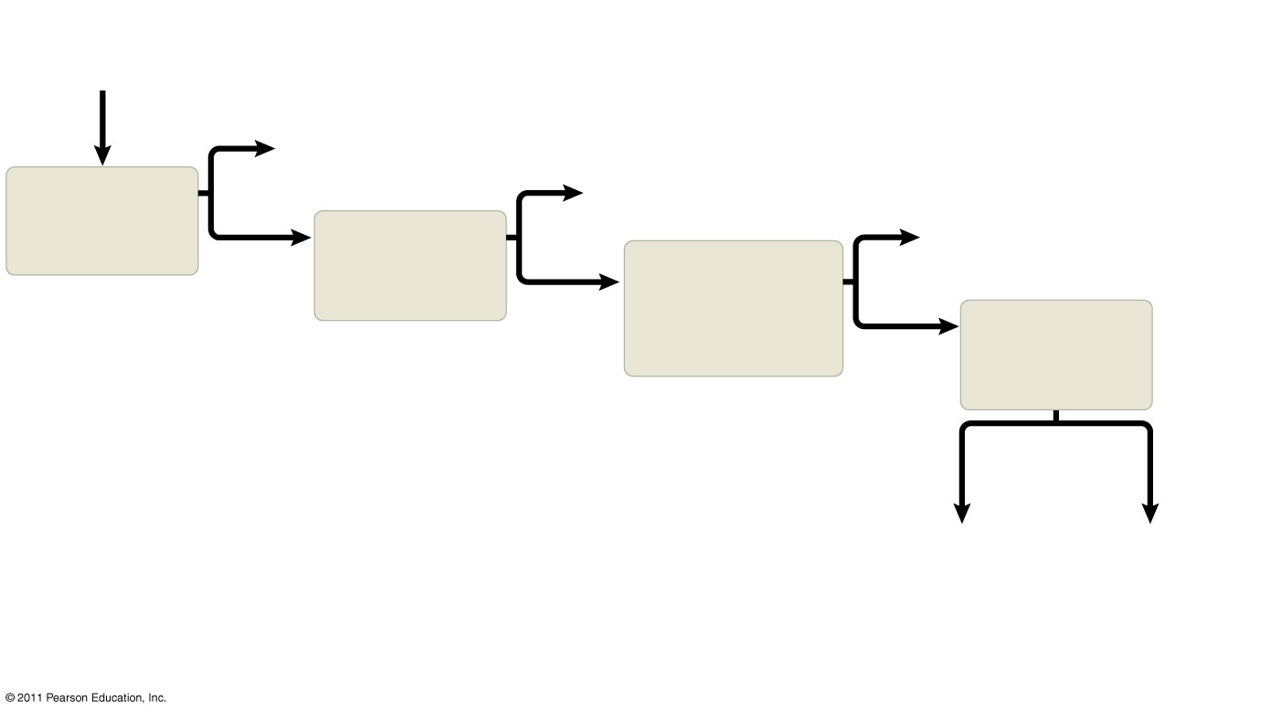
Figure 52.18
Ecologists ask questions about where species occur and why species occur where they do
Why is species
X absent
from an area?
Yes
Area inaccessible
or insufficient time
Yes
Predation,
parasitism,
competition,
disease
Does dispersal
limit its
distribution?
Habitat selection
Yes
Does behavior
limit its
distribution?
No
Do biotic factors
(other species)
limit its
distribution?
No
Do abiotic
factors limit its
distribution?
No
Physical
factors
Chemical
factors
Temperature
Light
Soil structure
Fire
Moisture, etc.
Water
Oxygen
Salinity
pH
Soil nutrients,
etc.
Notes:
Figure 52.18 Flowchart of factors limiting geographic distribution.

Slide 36
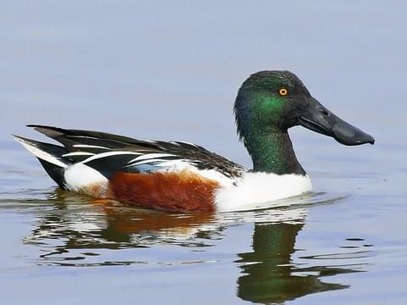

Slide 37
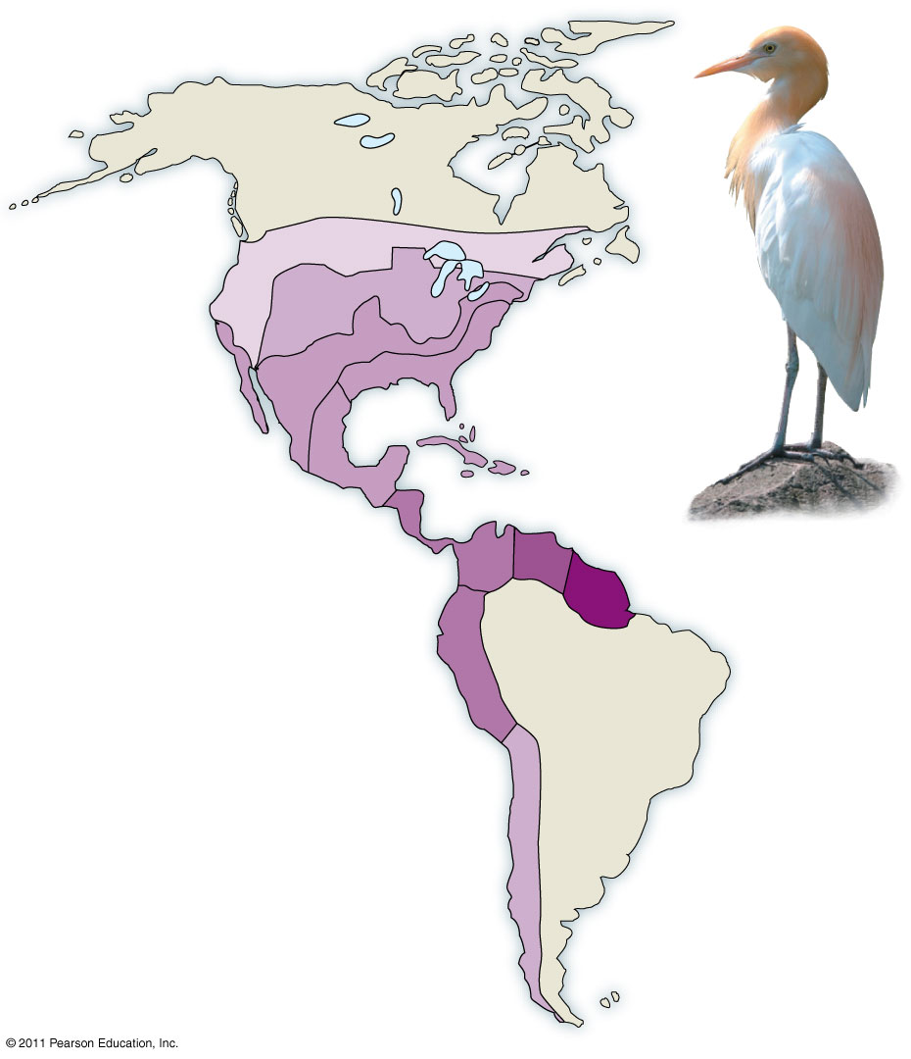
Figure 52.19
Current
1970
1966
1965
1960
1961
1943
1958
1951
1937
1956
1970
Notes:
Figure 52.19 Dispersal of the cattle egret in the Americas.

Slide 38
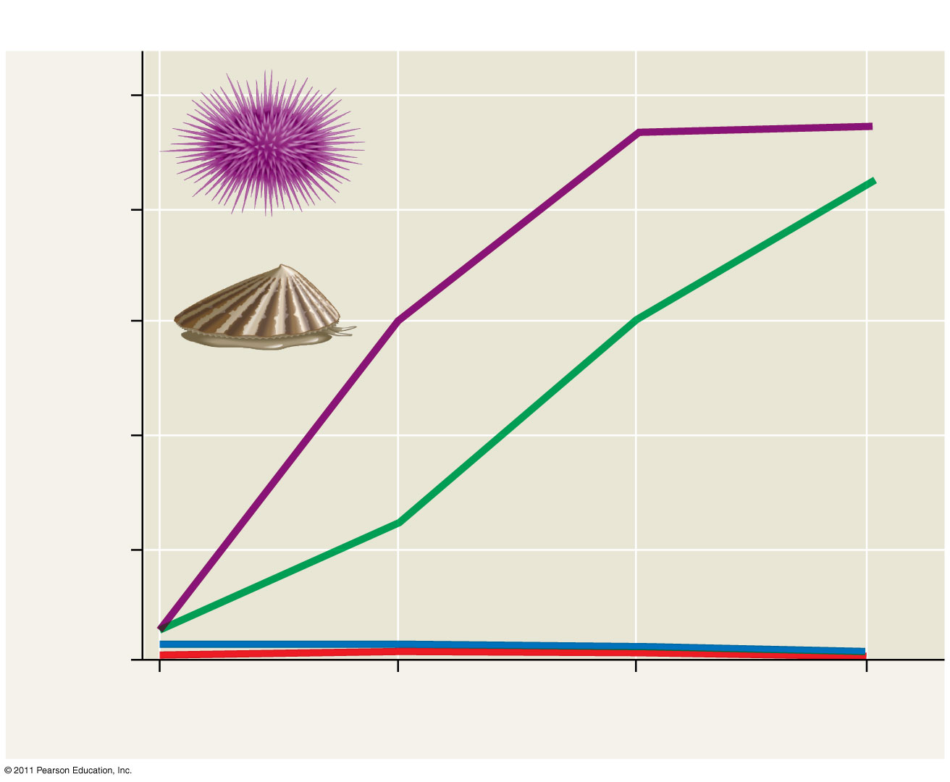
Influence of biotic factors on species distributions
100
Both limpets and urchins
removed
80
Sea urchin
Only urchins
removed
60
Seaweed cover (%)
Limpet
40
20
Only limpets removed
Control (both urchins
and limpets present)
0
August
1982
February
1983
August
1983
February
1984
Notes:
Figure 52.20 Inquiry: Does feeding by sea urchins limit seaweed distribution?

Slide 39
Abiotic Factors
Abiotic factors affecting the distribution of organisms include
Temperature
Water, oxygen
Sunlight
Salinity
Most abiotic factors can change in space and through time

Slide 40
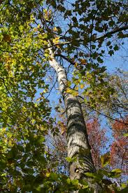
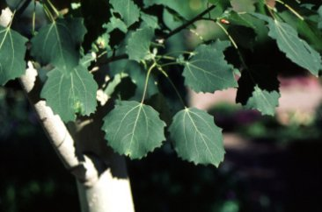
Accidents of History:
Bigtooth Aspen Is Absent from WSU Woods

